Slide 1
SECURE DATA HIDING IN IMAGES USING STEGAMOGRAPHY
Presented By: Brintika Saha
Student Name : Brintika Saha
College Name & Department : Heritage Institute Of Technology,ECE

Slide 2
OUTLINE
Problem Statement
Technology used
Wow factor
End users
Result
Conclusion
Git-hub Link
Future scope

Slide 3
Problem Statement
In an era where digital communication is constantly at risk of unauthorized access and interception, relying solely on traditional encryption methods may not guarantee complete security. Steganography offers a complementary approach by hiding the very presence of sensitive information within seemingly innocuous digital content. This project focuses on developing and implementing advanced steganographic techniques to embed confidential messages within digital images, enabling secure, covert communication while minimizing the risk of detection.

Slide 4
Technology used
Platform:
Python IDLE
Libraries:
OpenCV : For image processing and manipulation
NumPy: For handling and manipulating image arrays.
PIL(Pillow): For image handling and operations
Cryptography: For encrypting and securing the hidden messages.

Slide 5
Wow factors
Dual-Layer Security : Combines steganography with AES encryption for enhanced data protection.
Adaptive image selection : Uses AI to determine the best images for embedding hidden messages.
Robust Detection Resistance: Minimizes statistical anomalies,making detection nearly impossible.
Historical use: Stenography dates back to ancient times,including use in wartime espionage.
Invisibility: Messages can be hidden within images without visible changes.
Open Source Power: Libraries like OpenCV make image processing accessible and powerful.

Slide 6
End users
Government Agencies: Utilized for secure communication and intelligence operations.
Corporations: Protects sensitive business data from industrial espionage.
General Users: Allows individuals to privately communicate without detection.
Journalists and Whistleblowers: Ensuring secure communication and protecting national security.
Digital Forensics Experts: Investigating cybercrimes and safeguarding digital evidence.

Slide 7
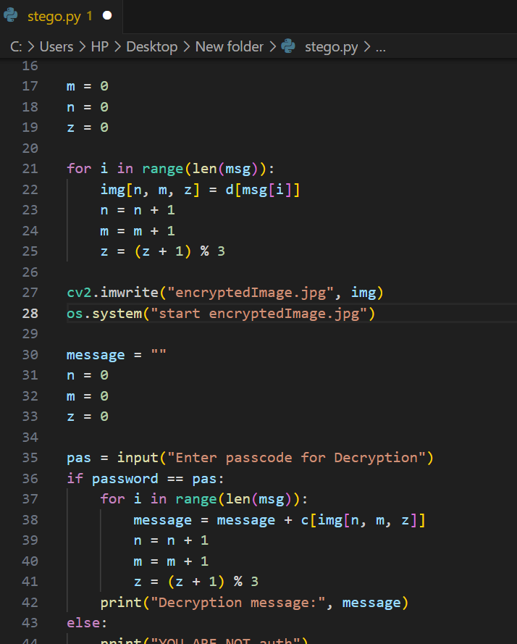

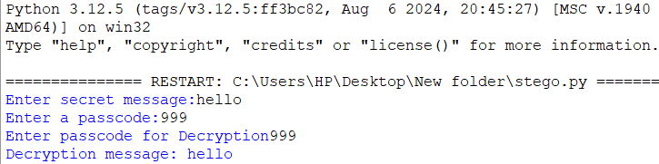

result
Output Image
Original Image
Steganographed
image
Encryption and Decryption code
User interface

Slide 8
Conclusion
This project demonstrates the advanced use of steganography to securely hide and retrieve messages within digital images. Utilizing Python and libraries like OpenCV, NumPy, and PIL, it ensures that sensitive information can be transmitted without detection by subtly modifying image pixels. This method enhances data privacy and security, making it valuable for personal, corporate, and governmental communications. To further strengthen protection, the project combines encryption with steganography, ensuring that even if the hidden message is detected, it remains unreadable without the decryption key. This dual-layer approach offers robust security while enabling discreet information exchange. Future advancements could include AI-driven automation and quantum-safe cryptographic techniques, enhancing resilience against evolving cybersecurity threats.

Slide 9
GitHub Link
https://github.com/Brintik897/Steganography_Project.git

Slide 10
Future scope(optional)
Advanced Algorithms: Develop more sophisticated steganographic techniques.
Quantum-Safe Encryption: Exploring cryptographic techniques resistant to quantum computing threats.
Blockchain Integration: Combine with blockchain for enhanced security.
Cloud-Based Steganography: Developing a web-based solution for secure online data hiding.
AI Utilization: Use AI to improve and counteract steganalysis.
Mobile Application: Bringing steganography to smartphones for secure on-the-go communication
Real-time Use: Apply in real-time communication like video streaming.
Commercial Applications: Expand use in cybersecurity, digital watermarking, and copyright protection.

Slide 11
THANK YOU

